Slide 1
Course Title Pakistan Studies
Instructor Name
Shamim Liaquat

Slide 2

Muslim Advent in Sub-continent

Slide 3
Advent of Islam in Sub-Continent
Sub continent has been remained important for all the states in all respect before the dawn of Islam.
It has been considered as a golden sparrow through out the history.
That’s under attacks of all major countries.
The Indian sub continent land where Islam emerged in the early centuries.
Now that million of Muslims live there and the Indian sub continent is regarded as a great member of the Islamic world, an understanding of how they became familiar with Islam is necessary.

Slide 4
Advent of Islam
The advent of Muslim political power in south Asia resulted from a number of factors including the absence of a strong, central authority in the sub continent.
Sea managing and maritime interest of the Arabs on the coast of India were considerable event before Islam.
Arabs having trade links via land route and sea route.
The Muslims traders played a very significant role in preaching Islam in the sub continent.
P. K. Hitti remarks
That it has passed through three distinct stages “ originally a religion, Islam later became a state and finally a culture”.

Slide 5
Causes of Advent of Islam
Brahmanism
Caste System
Lower Caste
Small States Warfare
Islam’s simplicity and equality
Matrimonial alliance
peace

Slide 6
Role of Traders
These individuals were the merchants in the west of sub continent specially the ones had come from Iran to India for the Commerce.
Propagandized Islam during the commercial activities or
Islamic influence first came to be felt in the Indian sub continent during the early 7th century with the advent of Arab Traders.
Arab traders used to visit the Malabar region, which was a link between them and the ports of south-East Asia to trade even before Islam had been established in Arabia.

Slide 7
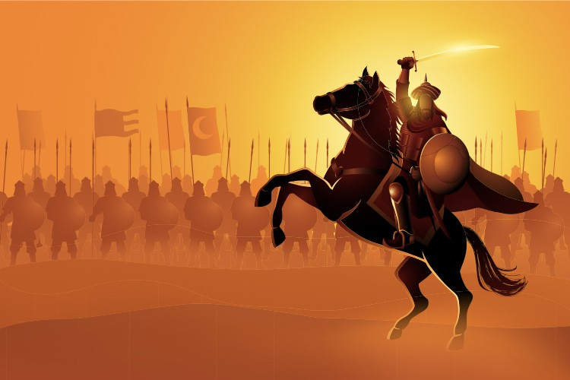
Muhammad Bin Qasim
In 712 A.D., Muhammad bin Qasim, the conqueror of Sindh made Sindh
Dar ul Islam and based his policy on the Sharia; the Laws of Islam
The majority of converts who entered the fold of Islam
Belonged to lower caste of Hindus
Suppressed by Hindu dominance
To whom Islam at once brought that social equality
which Hinduism had denied them from a long time.

Slide 8
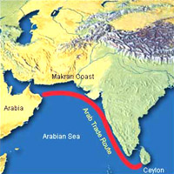
Sindh Dar UL Islam
Gifts and women from Ceylon
Pirates attack
Al Malik bin Abdul Malik as a Ummayyad Caliph
Hijaj Bin Yousaf
Muhammad Bin Qasim Syrian soldiers entered from Makran
Raja Dahir killed near Mehran (Indus) in june 712 A.D.
Treatment with people
No social caste system
Equality
Suleman bin Abdul Malik called MBQ back and perished him in 715 A.D.

Slide 9
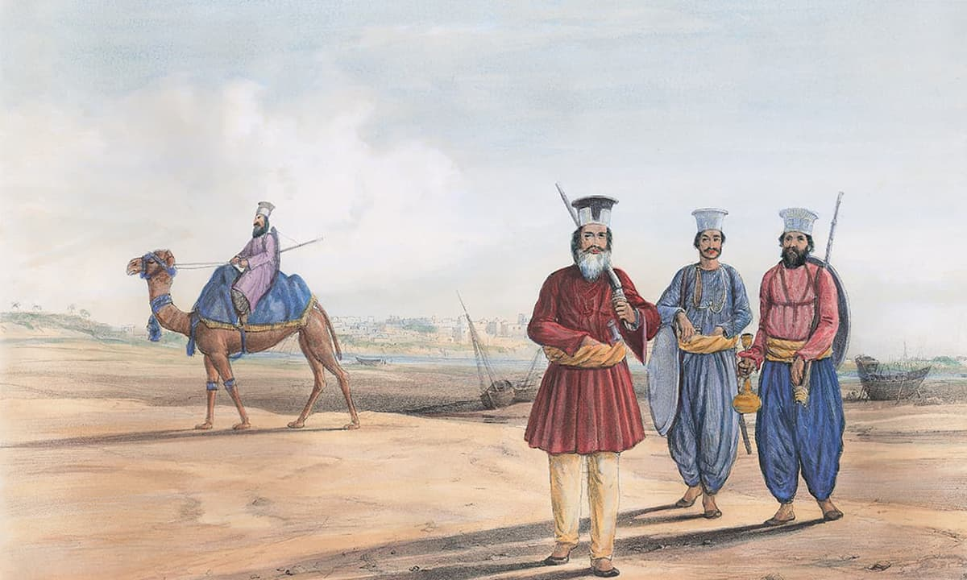
Islam after Muhammad Bin Qasim
Mehmud Gahznavi 2nd expediter 17 attacks between 1000 to 1026
Ghaznavid period ended in 1185 with death of Khusru Malik
Ghuri period (1185 – 1192) expanded to Bengal and bihar
Delhi Sultanate (1192-1526) Muslim Sufis
Mughal Era (1526-1857)

Slide 10
Advent of Islam
Islam expanded because of its pronounced emphasis on human equality, which attracted underprivileged groups to its fold.
Islam’s political and spiritual presence in the Indus valley since the late seventh century gradually helped the emergence of an enduring Muslim Factor.

Slide 11
Conti…..
Muslim factor that over the subsequent centuries, became quite pluralistic as its indigenous Arab, African, Persian, and Central Asian strands converged to form what came to be known as the Indo-Islamic Culture.
In a powerful way, this interplay between Islam and Indian values continued with their cultures, as both avoided completely assimilating each other.
South Asian Islam was a part of a larger Muslim tradition, but it reflected its own Indian embodiment in many areas, which made this interaction complex but mostly constructive.
Islam as political power, was entered as Muhammad bin Qasim attacked Debul in 712 A.D.

Slide 12
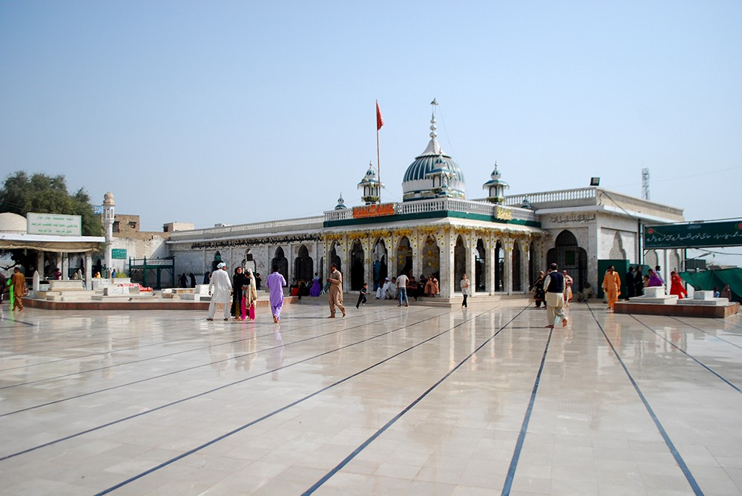
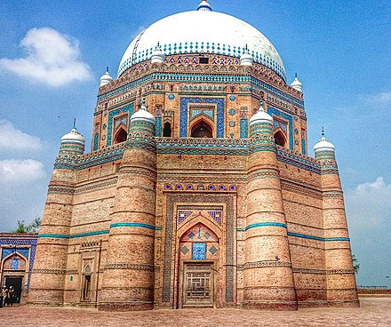
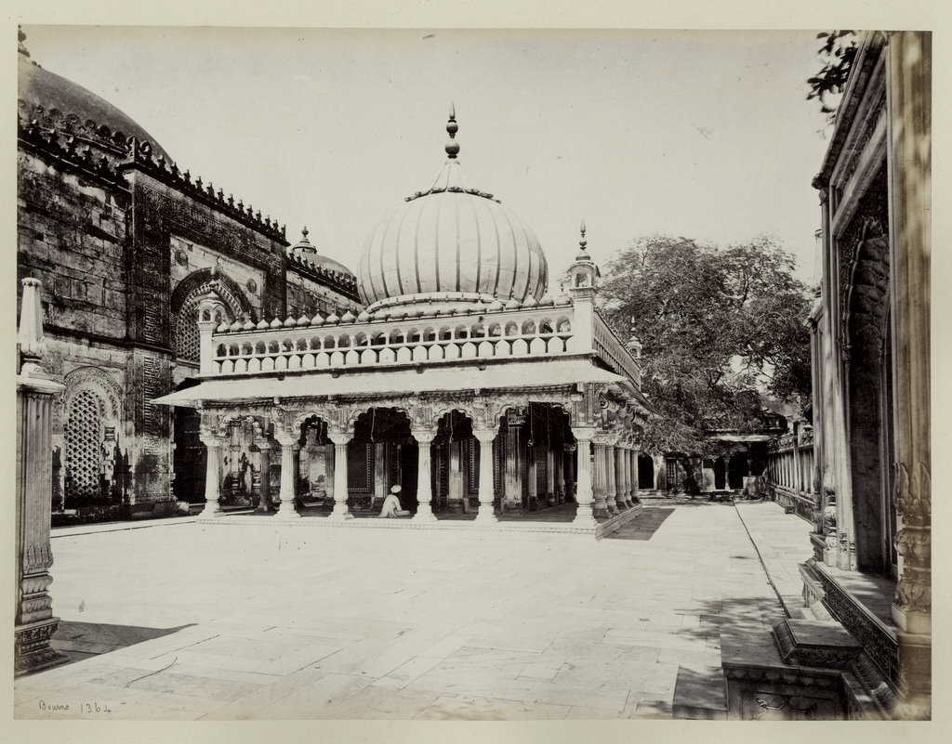
Role of Sufi’s
In sub continent, the Sufis made untiring, selfless and continue struggle for the spread, growth and evolution of Islam.
The spread of Islam stems from the invasion of Muhammad Bin Qasim in the Sub continent, but roots of Sufism took shape and became an institution in the 12th and 13th century.
Islam’s emphasis on human equality, peace and antiracism
The establishment of Sufi orders and contributions of people like
Data Gunj Bakhsh
Baba Farid ud Din Ganj Shakar
Baha ud Din Zakariya
Nizam ud Din Aulia
Amir Khusrau
Numerous others have been fully recorded

Slide 13
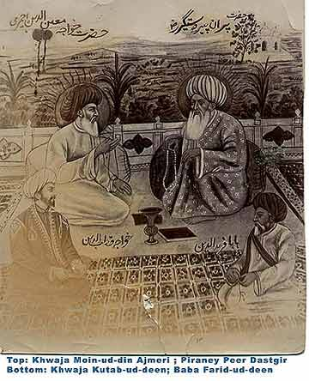
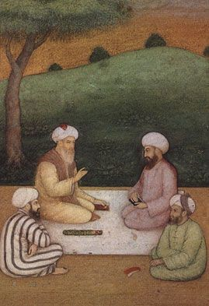
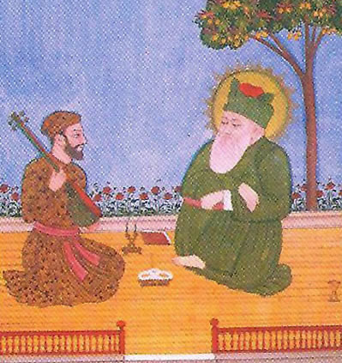
Conti…..
Through their spiritual efforts, they sought communal harmony.
It was their affection, sympathy, fraternity and unlimited philanthropist actions that won the hearts of people.
The series of Muslim-ruling dynasties since the Arab conquest of the Indus valley in 71 A.D. added to the south Asian socio- religious pluralism and established a long tradition of Muslim rule.

Slide 14
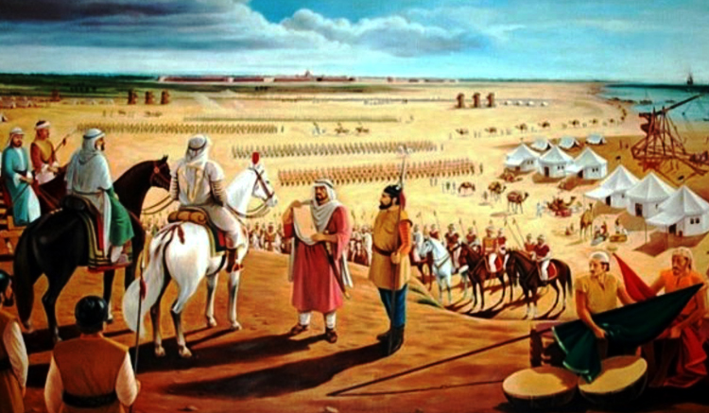
Rulers and growth of Islam
Islam in sub continent grew more strongly because of Islamic rule there.
But, at the same time, it is wrong to assume that if missionaries had not received a fresh impulse under the Muslim dynasties, its propagation would have been checked.
The Islamic clergy also paved the way for growth of Islam in sub continent.

Slide 15
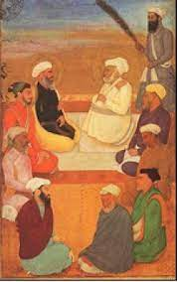
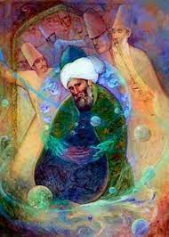
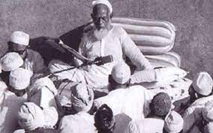
Impact
Political Influence
Strong Central Government
Establishment of Peace and Harmony
Educational Influence
Development in Education System –Arabic, Persian and Urdu Languages
Indo Islamic Art – Calligraphy and Architecture

Slide 16
Impacts
Muslim Rule
Islam Flourished
Shankarachariya (Organizer of modern Hinduism) influenced by Islam.
Ramananda, Ghuru Nanik were prominent Hindu leaders influenced by Islam.
Equality to Suppressed Classes.
Cultural Influence
Caste System
Urdu and Hindu existence
Islamic way of construction

Slide 17
Impact
Hindu reaction
Bagti Movement (Bagt Kabir)
Started in 14th century
Objective to check the popularity of Islam.
No difference between Ram and Raheem
Others
Din e Elahi 1582
Muslim Reformist Movement
Mujadid Alif Sani
Shah Wali Ullah

Slide 18
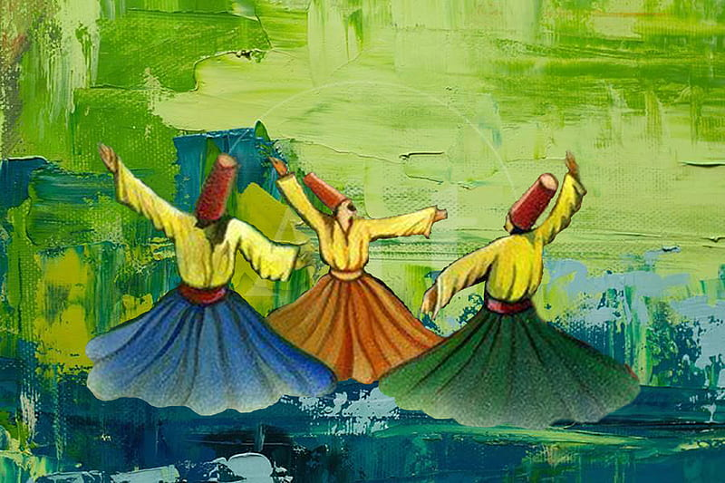
Conclusion
Above all, it was the sheer struggle of Sufi’s which paved the way for the future Islamic state in the Sub continent.
Sufi’s had their practice of Islamic teaching in the 13th ad 14th Century, it would have been difficult to implant a Muslim Civilization in the country where a well Organized Hindu Community had lived for Centuries.

Slide 19

Thank you

